Slide 1

Second Review
Minor Project-2 Summer Semester-2024-25
Department of Electronics and Communication Engineering
HAZE REMOVAL OF UNDER WATER IMAGES USING DEEP LEARNING TECHNIQUES
Domain: SIGNAL PROCESSING
Date:30-10-2024
Project Team Members
VTU 21181(ADURU PAVAN KUMAR)
VTU 21166(ARAVANTI YASHWANTH)
VTU 21196(MADDURU RAJESH)
Supervisor: Dr.ASHWINI.A

Slide 2
Content
Literature survey
Introduction
Methodology
Design and implementation
Results and Discussion
Conclusions
References

Slide 3
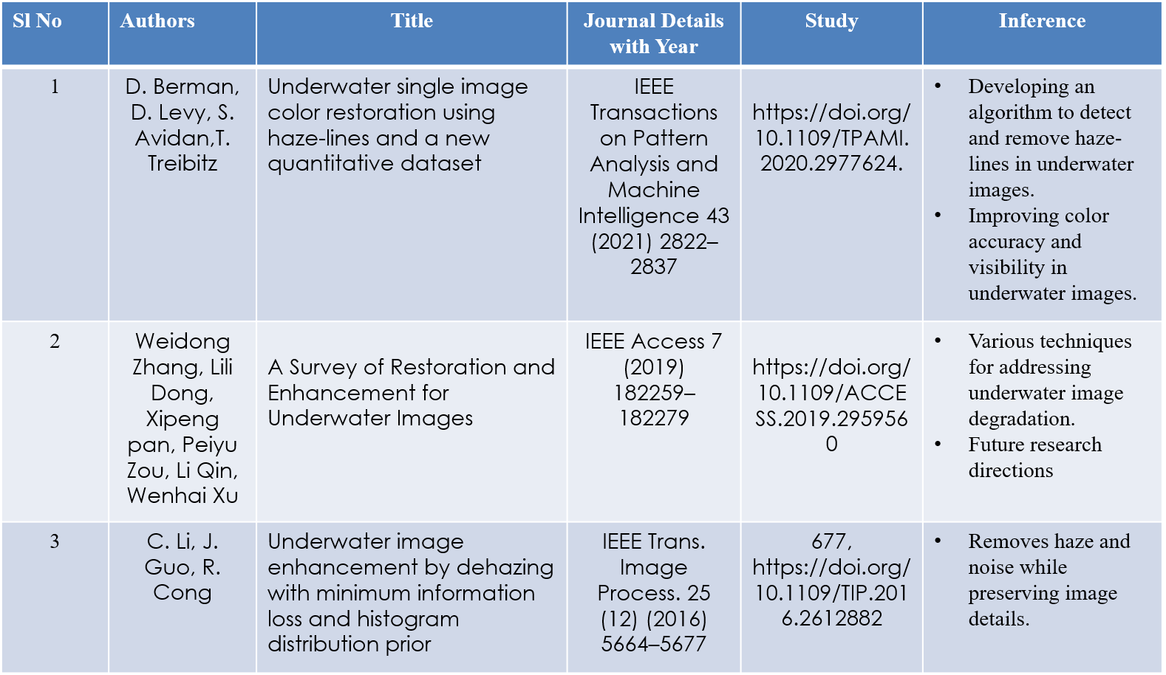
LITERATURE SURVEY

Slide 4
INTRODUCTION
Underwater imaging is becoming more and more important in many areas, including environmental monitoring, underwater robotics, marine biology, and underwater archaeology.
Haze, poor contrast, color distortion, and blurring are common problems in the resultant images, which can obfuscate crucial details and complicate image analysis and interpretation.
The intrinsic qualities of water as a medium are the main reason why underwater photos degrade.
Light is absorbed and scattered when it passes through water, with shorter wavelengths (green and blue) penetrating farther than longer wavelengths (red).

Slide 5
METHODOLOGY
A. Histogram Equalization :
This strategy ordinarily assembles the overall separation of various pictures, especially when the usable data of the image tends to close distinction.
The procedure is important in pictures with establishment and closer perspectives that are both magnificent and dull.
B. Decision Tree Classification Algorithm :
This is a dual-natured supervised learning approach. Although it is best suited for classification, it can be used for regression as well. An object representation of this would be a tree.
The internal nodes contain the data features, the branches include the decision rules, and the leaf node has the result

Slide 6
C. Under water Image DataSet :
A collection of photos captured underwater for use in scientific, industrial, and research purposes is referred to as an underwater image dataset. For the advancement of disciplines like computer vision, underwater robotics, and marine biology, these databases are essential.
Types Of Under Water Images:
RGB Images
Depth Maps
Sonar Images
Multispectral And Hyperspectral Images
D. Training &Testing of Datasets :
Deep learning techniques for training and testing underwater photos entail employing sophisticated neural network models to solve issues with limited visibility, blurriness, and color distortions that are common in underwater environments. The objective is to achieve better results on underwater picture enhancement, object detection, classification, and segmentation tasks.

Slide 7
DESIGN
Start
Under Water Image Dataset
Testing
Training
Preprocessing
Enhanced Image
Decision Tree Classification Algorithm

Slide 8
IMPLEMENTATION
Code:
%% Step 1: Display Input Image
rgbImage = imread('1.jpg');
rgbImage = im2double(rgbImage); % Convert to double precision
figure('Name', 'Step 1: Input Image');
imshow(rgbImage);
title('Input Image');
%% Step 2: Image Preprocessing
% Resize the image (Optional)
resizedImage = imresize(rgbImage, [512, 512]);
preprocessedImage = imbilatfilt(resizedImage, 0.01, 2);
% Histogram equalization for contrast enhancement (HSV space)
hsvImage = rgb2hsv(preprocessedImage); % Convert RGB to HSV
hsvImage(:,:,3) = histeq(hsvImage(:,:,3)); % Equalize the 'V' channel (intensity)
preprocessedImage = hsv2rgb(hsvImage); % Convert back to RGB

Slide 9
% Display the preprocessed image
figure('Name', 'Step 2: Preprocessed Image');
imshow(preprocessedImage);
title('Preprocessed Image');
%% Step 3: Improved White Balancing (using scaling factors)
meanR = mean2(preprocessedImage(:,:,1));
meanG = mean2(preprocessedImage(:,:,2));
meanB = mean2(preprocessedImage(:,:,3));
meanGray = (meanR + meanG + meanB) / 3;
scaleR = meanGray / meanR;
scaleG = meanGray / meanG;
scaleB = meanGray / meanB;
whiteBalancedImage = preprocessedImage;
whiteBalancedImage(:,:,1) = preprocessedImage(:,:,1) * scaleR;
whiteBalancedImage(:,:,2) = preprocessedImage(:,:,2) * scaleG;
whiteBalancedImage(:,:,3) = preprocessedImage(:,:,3) * scaleB;
whiteBalancedImage = min(whiteBalancedImage, 1);
% Display the white-balanced image
figure('Name', 'Step 3: White Balanced Image');
imshow(whiteBalancedImage);
title('White Balanced Image');

Slide 10
%% Step 4: Adjust Gamma Correction to Avoid Over-lightening
% Apply Gamma correction with a slightly higher value to avoid lightening too much
gammaCorrectedImage = imadjust(whiteBalancedImage, [], [], 0.8);
% Display the gamma-corrected image
figure('Name', 'Step 4: Gamma Corrected Image');
imshow(gammaCorrectedImage);
title('Gamma Corrected Image');
%% Step 5: Sharpen the Image
sharpenedImage = imsharpen(gammaCorrectedImage, 'Radius', 2, 'Amount', 1.5);
% Display the sharpened image
figure('Name', 'Step 5: Sharpened Image');
imshow(sharpenedImage);
title('Sharpened Image’);
%% Step 6: Image Fusion using Wavelet Transform
fusedImage = wfusimg(gammaCorrectedImage, sharpenedImage, 'sym4', 3, 'max', 'max');
% Display the fusion result
figure('Name', 'Step 6: Wavelet Fused Image');
imshow(fusedImage);
title('Wavelet Fused Image');

Slide 11
%% Step 7: Segmentation using K-means Clustering
tic;
labImage = rgb2lab(whiteBalancedImage);
ab = labImage(:,:,2:3);
ab = im2single(ab);
nrows = size(ab, 1);
ncols = size(ab, 2);
ab = reshape(ab, nrows*ncols, 2);
% Set the number of clusters (k)
num_clusters = 3;
opts = statset('MaxIter', 500, 'Display', 'final');
[cluster_idx, ~] = kmeans(ab, num_clusters, 'distance', 'sqEuclidean', 'Replicates', 3, 'Options', opts, 'Start', 'plus');
pixel_labels = reshape(cluster_idx, nrows, ncols);
executionTime = toc;
disp(['Execution Time for K-means Segmentation: ', num2str(executionTime), ' seconds']);
figure('Name', 'Step 7: Segmented Image (K-means)');
imshow(pixel_labels, []);
title('Segmented Image (K-means)');
segmented_images = cell(1, num_clusters);
for k = 1:num_clusters
color = whiteBalancedImage;

Slide 12
color(repmat(pixel_labels ~= k, [1, 1, 3])) = 0; % Set non-cluster pixels to zero
segmented_images{k} = color;
end
% Display segmented regions
figure('Name', 'Step 7: Segmented Regions');
for k = 1:num_clusters
subplot(1, num_clusters, k);
imshow(segmented_images{k});
title(['Cluster ', num2str(k)]);
end
%% Step 8: Load Ground Truth Image for Accuracy, Sensitivity, and Specificity Calculations
groundTruthImage = imbinarize(rgb2gray(imread('1.jpg')));
groundTruthImage_resized = imresize(groundTruthImage, [nrows, ncols]);
% Initialize variables for true positives, true negatives, false positives, and false negatives
TP = 0; TN = 0; FP = 0; FN = 0;

Slide 13
% Calculate true positives, false positives, true negatives, and false negatives
for k = 1:num_clusters
clusterMask = pixel_labels == k; % Mask for the current cluster
TP = TP + sum((clusterMask == 1) & (groundTruthImage_resized == 1)); % True Positive
TN = TN + sum((clusterMask == 0) & (groundTruthImage_resized == 0)); % True Negative
FP = FP + sum((clusterMask == 1) & (groundTruthImage_resized == 0)); % False Positive
FN = FN + sum((clusterMask == 0) & (groundTruthImage_resized == 1)); % False Negative
End
% Calculate accuracy, sensitivity, and specificity
accuracy = (TP + TN) / (TP + TN + FP + FN);
sensitivity = TP / (TP + FN); % True Positive Rate (Recall)
specificity = TN / (TN + FP); % True Negative Rate
% Display the calculated metrics
disp(['Accuracy: ', num2str(accuracy)]);
disp(['Sensitivity: ', num2str(sensitivity)]);
disp(['Specificity: ', num2str(specificity)]);

Slide 14
%% Step 9: SSIM and PSNR Calculations
refImage = im2double(imread('1.jpg'));
refImage_resized = imresize(refImage, [nrows, ncols]);
if size(refImage_resized, 3) == 1
refImage_resized = cat(3, refImage_resized, refImage_resized, refImage_resized);
end
ssimValue = ssim(fusedImage, refImage_resized);
psnrValue = psnr(fusedImage, refImage_resized);
disp(['SSIM: ', num2str(ssimValue)]);
disp(['PSNR: ', num2str(psnrValue)]);
%% Step 10: Display Final Enhanced Image
% Final enhanced image after all steps (gamma correction, sharpening, and wavelet fusion)
finalEnhancedImage = fusedImage;
% Display the final enhanced image
figure('Name', 'Final Enhanced Image');
imshow(finalEnhancedImage);
title('Final Enhanced Image');

Slide 15
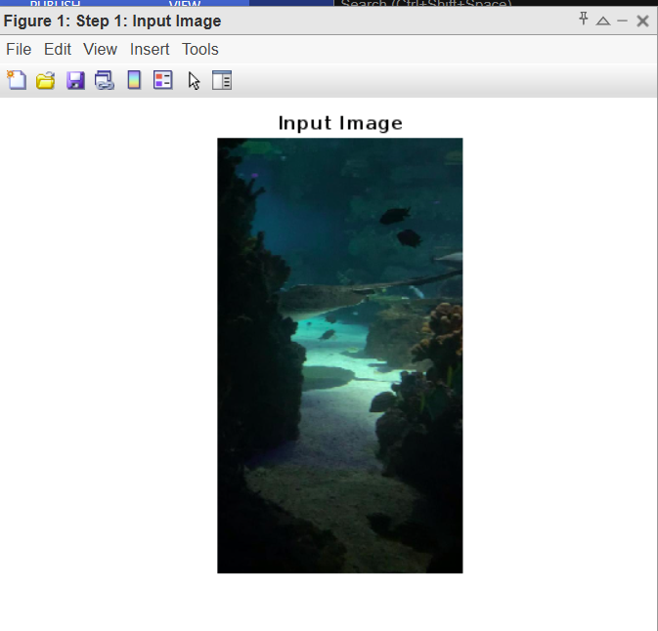
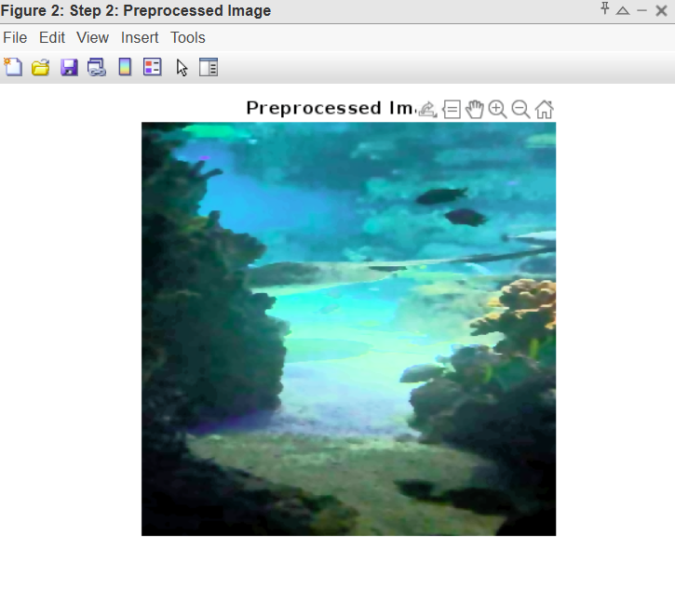
Results and Discussion

Slide 16
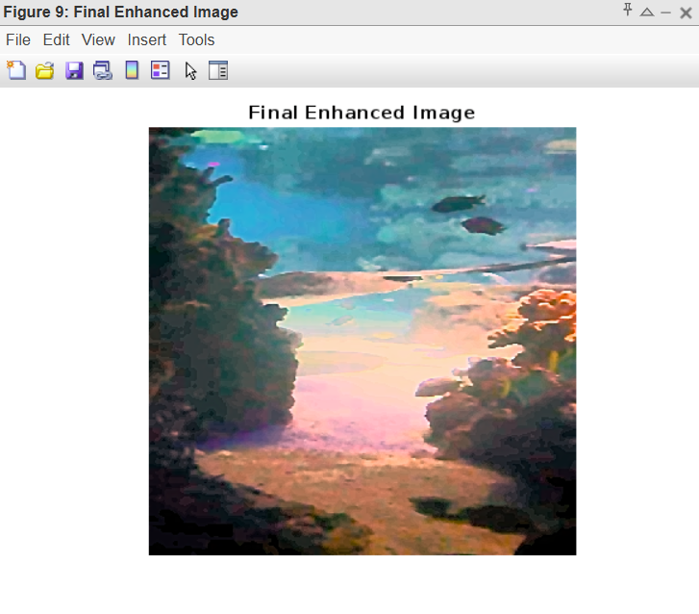

Slide 17
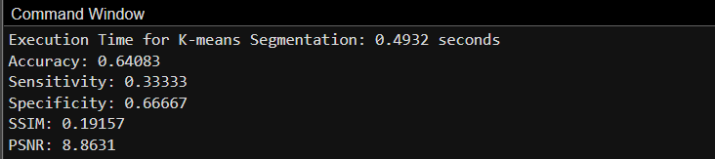
Conclusions
Pre-processing :
Removing noise, normalizing pixel values, or correcting for sensor imperfections.
White balance:
Adjusting color temperature to neutralize color casts and improve color accuracy.

Slide 18
Gamma correction:
Adjusting image brightness and contrast to improve visual appearance.
Sharpened Image:
Enhancing image details using filters (e.g., unsharp mask) to improve clarity.
Wavelet Segmentation:
Using wavelet transforms to decompose the image into different frequency bands for segmentation.
Enhanced image:
Final output image after applying the above preprocessing steps.

Slide 19
References
[1] C. Li, J. Guo, R. Cong, Underwater image enhancement by dehazing with minimum information loss and histogram distribution prior, IEEE Trans. Image Process. 25 (12) (2016) 5664–5677, https://doi.org/10.1109/TIP.2016.2612882.
[2] D. Garg, N.K. Garg, M. Kumar, Underwater image enhancement using blending of CLAHE and percentile methodologies, Multimedia Tools Apply 77 (20) (2018) 26545–26561, https://doi.org/10.1007/s11042-018-5878-8.
[3] J. Zhou, L. Pang, D. Zhang, W. Zhang, Underwater Image Enhancement Method via multi-interval Subhistogram Perspective Equalization, IEEE Journal of Oceanic Engineering 48 (2) (2023) 474–488, https://doi.org/10.1109/joe.2022.3223733.
[4] Y. Zhou, Q. Wu, K. Yan, L. Feng, W. Xiang, Underwater image restoration using color-line model, IEEE Transactions Circuits System and Video Technologies 29 (3) (2019) 907–911, https://doi.org/10.1109/TCSVT.2018.2884615.

Slide 20


